Slide 1
MOSFET Bsim3V3
Model Optimization Strategy

Slide 2
Model Optimization Strategy
Optimization Strategies:
1. CV fitting: including Cgg / Cgc / Cgd / Cgs / Cgb
2. DC fitting:
a) Id_Vgs_Vbs of the linear region at low Vds
b) Id_Vgs_Vbs of sub-threshold region for both low and high Vds
c) Id_Vds_Vgs of saturation region for both Vbs=0 and Vbs not 0
d) Rout_Vds_Vgs of saturation region for both Vbs=0 and Vbs not 0
f) Isub_Vgs_Vds of the ionization impact for Vbs=0
g) Id_Vgs_Vbs of linear region at low Vds and Id_Vds_Vgs of saturation
region at Vbs=0 for various temperature.

Slide 3
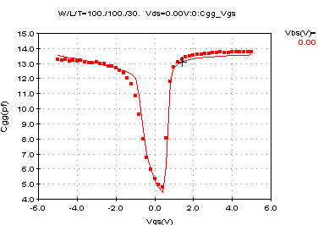
CV fitting for the biggest and the large W/L device
1. Optimize Tox, Vth0, Ngate, moin, acde, noff, Voffcv from the biggest device with dedicated PAD
Optimize Tox, Vth0, Ngate, moin, acde, noff, Voffcv

Slide 4
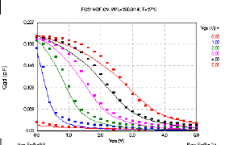
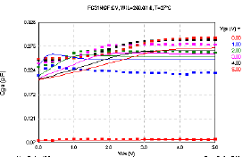
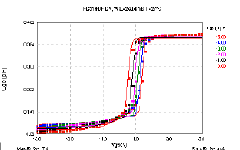
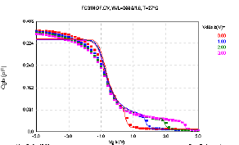
2. Optimize Cgdo, Cgso, Cgdl, Cgsl, Dlc, Dwc, Clc, Cle from the biggest device with dedicated PAD
Optimize Cgdo, Cgso, Clc, Cle,
Optimize Cgdl, Cgsl, Dlc, Dwc,

Slide 5
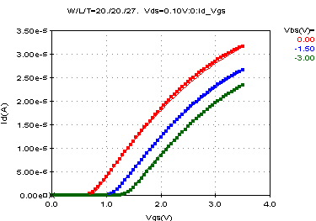
Id_Vgs_Vbs of linear region at low Vds
1. Optimize Vth0, K1, K2, U0, Ua, Ub, Uc from large device
Optimize Vth0
Optimize K1, K2

Slide 6
Optimize U0
Optimize Ua, Ub
Optimize Uc

Slide 7
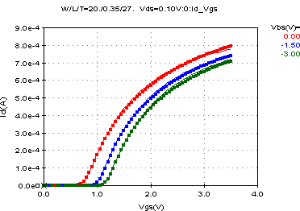
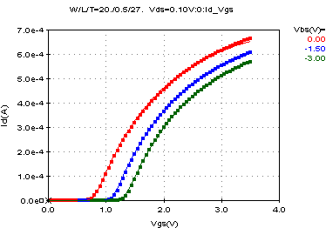
2. Optimize Lint, LL, LLN, Dvt0, Dvt1, Nlx,Dvt2, Rdsw, Prwg, Wr, Prwb from the set of devices (large and fixed W and different L)
Optimize Dvt0, Dvt1, Nlx

Slide 8
Optimize Dvt2 for the body effect
Optimize Lint, LL, LLN

Slide 9
Optimize Rdsw, Prwg, Wr
Optimize Prwb for body effect

Slide 10
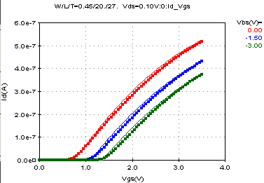
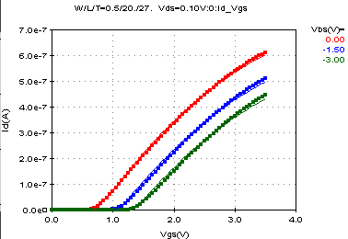
3. Optimize Wint, Ww, Wwn, K3, W0, K3b, Dwg, Dwb from the set of devices (large and fixed L and different W)
Optimize K3, W0

Slide 11
Optimize K3b
Optimize K3, W0

Slide 12
Optimize Dwg
Optimize Dwb

Slide 13
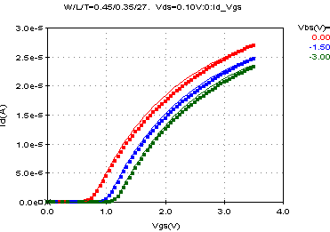
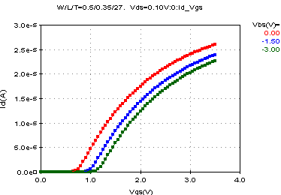
4. Optimize Wwl, Wln, Dvt0w, Dvt1w, Dvt2w from the set of devices (short and fixed L and different W)
Optimize Dvt0W, Dvt1W

Slide 14
Optimize Dvt2W
Optimize Wwl, Wln

Slide 15
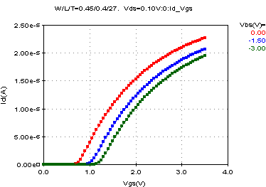
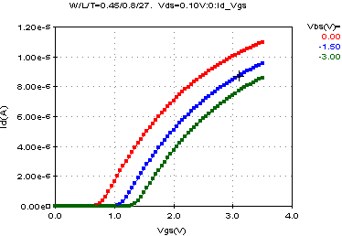
5. Optimize Lwl, Lwn from the set of devices (narrow and fixed W and different L)
Optimize Lwl, Lwn

Slide 16
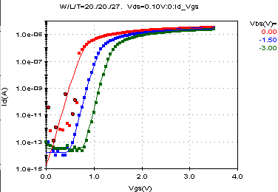
Id_Vgs_Vbs of sub-threshold region for both low and high Vds
1. Optimize Nfactor, Voff, Cit from the large devices
Optimize Nfactor, Voff, Cit

Slide 17
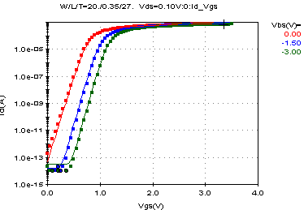
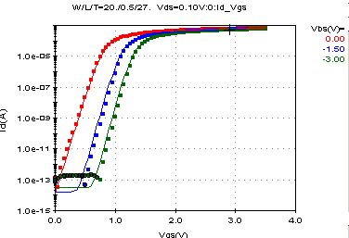
2. Optimize Cdsc, Cdscb from the set of devices (large and fixed W and different L) at low Vds
Optimize Cdsc
Optimize Cdscb

Slide 18
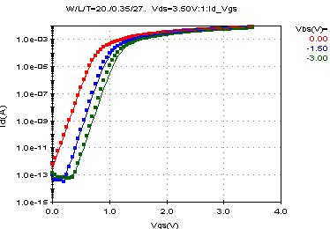
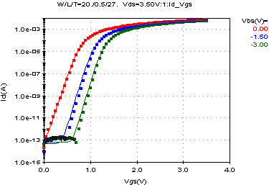
3. Optimize Cdscd, Eta0, Dsub, Etab from the set of devices (large and fixed W and different L) at high Vds
Optimize Cdscd, Eta0, Dsub
Optimize Etab

Slide 19
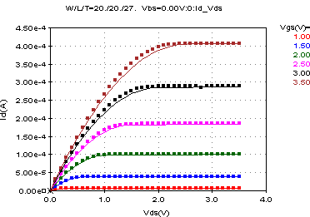
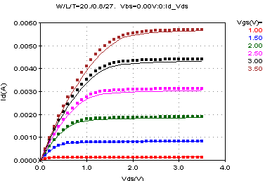
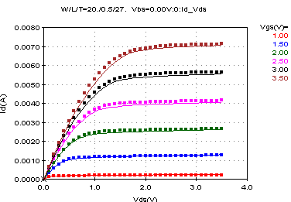
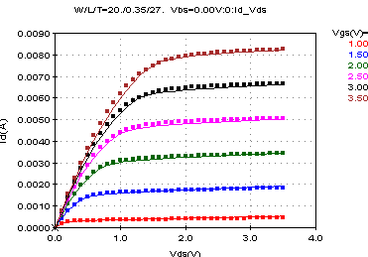
Id_Vds_Vgs of saturation region for Vbs=0 and Vbs not equal to 0
1. Optimize Vsat, A0, (A1, A2 for PMOS mostly), Ags, Pclm, Pvag, Pdiblc1, Piblc2, Drout, Pscbe1, Pscbe2 from the set of devices (large and fixed W and different L) at Vbs=0. A rough fitting is fine for saturation region.

Slide 20
2. Optimize A0, Ags from large devices at Vbs=0
3. Optimize Vsat, (A1, A2 for PMOS mostly) from the set of devices (large and fixed W and different L) at Vbs=0
Optimize A0, Ags
Optimize Vsat, (A1, A2)

Slide 21
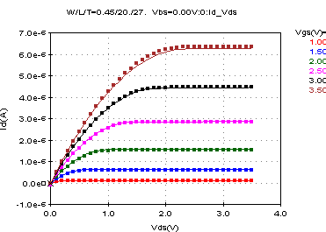
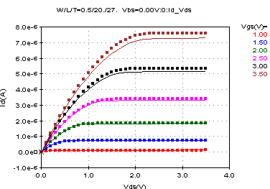
4. Optimize B0, B1 from the set of devices (large and fixed L and different W) at Vbs=0
Optimize B0, B1

Slide 22
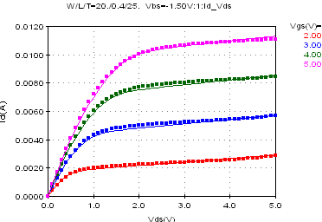
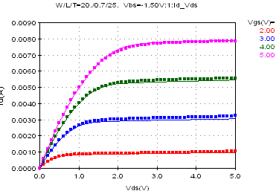
5. Optimize Pdiblcb from the set of devices (Large and fixed W and different L) at Vbs not equal 0
Optimize Pdiblcb

Slide 23
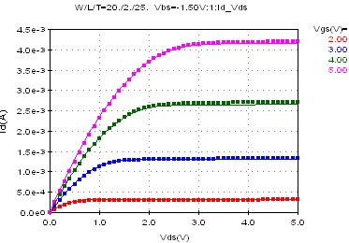
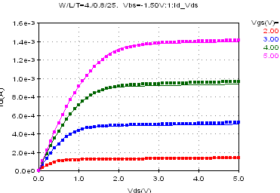
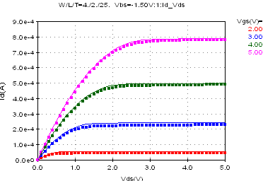
6. Optimize Keta from the set of devices (different L and W) at Vbs not equal 0
Optimize Keta

Slide 24
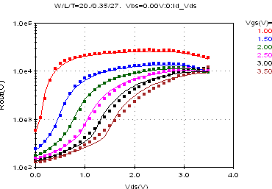
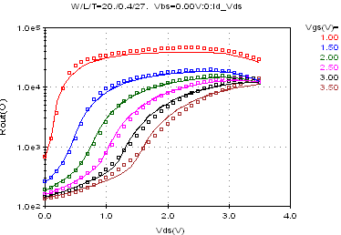
Rout_Vds_Vgs of saturation region for Vbs=0 and Vbs not equal to 0
1. Optimize Pclm, Pvag from the set of devices (large and fixed W and different L) at Vbs=0
Optimize Pclm, Pvag

Slide 25
2. Optimize Pdiblc1, Pdiblc2 from the set of devices (large and fixed W and different L) at Vbs=0
Optimize Pdiblc1, Pdiblc2

Slide 26
3. Optimize Pscbe1, Pscbe2 from the set of devices (large and fixed W and different L) at Vbs=0
Optimize Pscbe1, Pscbe2

Slide 27
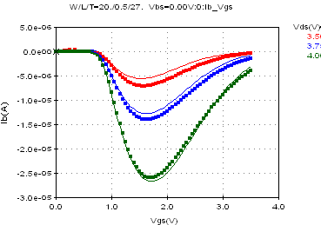
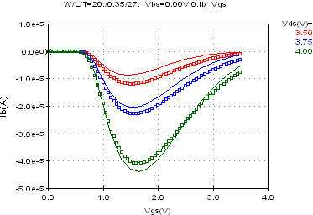
Isub_Vgs_Vds of the ionization impact for Vbs=0
1. Optimize Alpha0, Alpha1 and Beta0 from the set of devices (large and fixed W and different L) at Vbs=0
Optimize Alpha0, Alpha1, Beta0

Slide 28
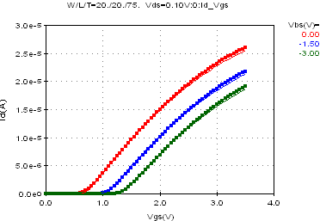
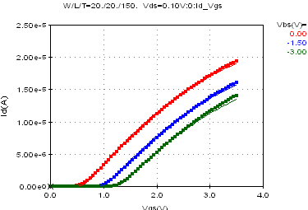
Id_Vgs_Vbs of linear region at low Vd for various temperature
1. Optimize Kt1, Kt2, Ute, Ua1, Ub1, Uc1 from large device
Optimize Kt1

Slide 29
Optimize Kt2
Optimize Ute

Slide 30
Optimize Ua1, Ub1
Optimize Uc1

Slide 31
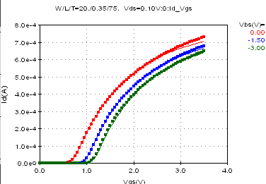
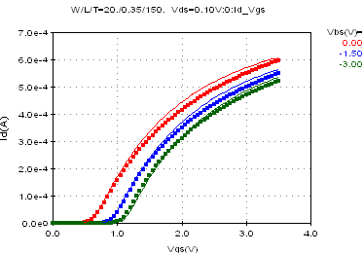
2. Optimize Kt1l, Prt from a set for devices (large and fixed W and different L) @ Vbs=0
Optimize Kt1l

Slide 32
Optimize Prt

Slide 33
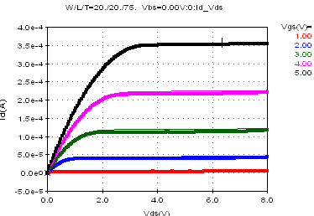
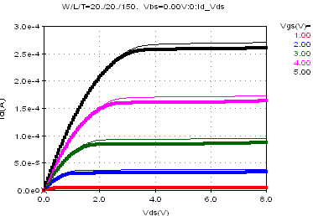
Id_Vds_Vgs of saturation region at Vbs=0 for various temperature
1. Optimize At from the set of devices (large and fixed W and different L)
Note: We also should check the corner device to verify the temperature model

Slide 34
Model QA
Including the single model QA and the model library QA, which will be discussed in the “Modeling QA flow”

